Slide 1
Pharmaceutical Management of Cardiac Medications: A Look at New Oral Anticoagulants
Linda Wing, R.Ph.
Risik Rask, Pharm.D.
Notes:
Introductions

Slide 2
Nothing to Disclose
Notes:
Risik

Slide 3
Identify the characteristics of the ideal anticoagulant and the shortfalls with the current treatment options
Introduce the New Oral Anticoagulants (NOAC) on the market and agents still under investigation
Describe the key trials that lead to the approval of the NOACs
Understand how the NOACs work and their place in therapy
Review the current monitoring options available for NOACs
Recognize reversal options for the NOACs
Notes:
Risik

Slide 4
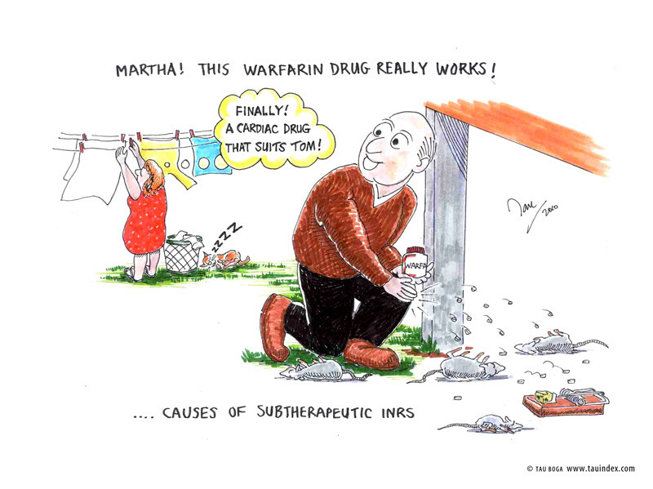
Rationale for New Anticoagulants
Warfarin – Approved in 1954
Narrow therapeutic index
Many Food/Drug Interactions
Slow Onset and Offset
Frequent lab monitoring
Bad Reputation
Does have antidote
Vitamin K (Phytonadione)
Notes:
(Linda)
narrow therapeutic index = INR 2-3 or 2.5-3.5
FDI – almost all medications and a lot of food, vitamin k rich foods, mayonaise
Slow on/offset – 4-5 days before therapeutic that’s due to the half life of vitamin K dependent clotting factor – 10, 9 , 7, 2, Factor II or antithrombin has the longest half-life of 4-5 days – bridging required if interrupting therapy
Frequent lab monitoring - usually pts go daily to every other day in the beginning and transition to min of 1/month
Bad rep – rat poison – see cartoon
BUT it does have an antidote vitamin K

Slide 5
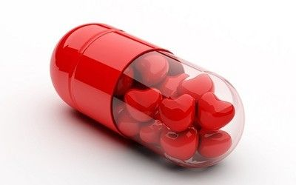
The Ideal Anticoagulant…
Oral Administration
Fast Onset/Offset
Predictable Response
Availability of Reversal Agent
No Food/Drug Interactions
No Need to Monitor but Able to if Needed
Low Incidence of Adverse Effects
Cost Effective
Notes:
Risik

Slide 6
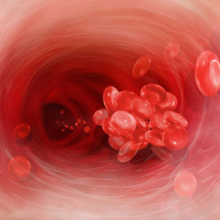
New Oral Anticoagulants (OACs)
Direct Thrombin Inhibitors (DTIs)
Ximelagatran (Exanta®)
Withdrawn in 2006 due to severe hepatotoxicity
Dabigitran (Pradaxa®)
Approved in October 2010
Factor Xa Inhibitors
Rivaroxaban (Xarelto®)
Approved in July 2011
Apixaban(Eliquis®)
Approved December 2012
Edoxaban (Lixiana®)
Currently in Phase III Clinical Trial
Approved in Japan
Betrixiban
Currently in Phase III Clinical Trial
Notes:
(Linda)
There are 2 classes of drugs currently being investigated
DTI’s on market today included Argatroban, Bivalirudin, Lepirudin
Ximelagatran – initial appoved in Europe and used extensively – never really took off in the US,
Factor Xa inhibitor currently exists but as an injection (fondaparinux)

Slide 7
Notes:
Risik

Slide 8
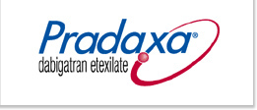
Direct Thrombin Inhibitors (DTIs) “-trans”
Dabigitran (Pradaxa®)
FDA approval in October 2010
Indicated for prevention of Stroke and Systemic embolism in patients with non-valvular atrial fibrillation
Approved in Europe/Canada for venous thromboembolism (VTE) prevention following knee and hip surgery
First oral anticoagulant in over 50 years
Notes:
Linda

Slide 9
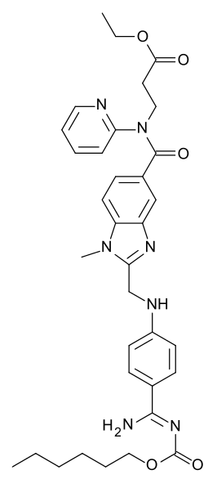
Dabigitran Trials
RE-LY Trial
Studied both 110mg and 150mg twice daily in patients with Atrial Fibrillation (AF)
110mg group was non-inferior to Warfarin for prevention of stroke and systemic embolism with lower rates of major bleeding
150mg group was associated with LOWER rates of stroke and systemic embolism with similar rates of major bleeding with Warfarin
FDA Approved
RE-DEEM Trial
Studied in Acute Coronary Syndromes in conjunction with antiplatelet drugs
Phase II Trial
Not FDA approved
RECOVER-I & RECOVER II
Treatment of acute VTE compared to warfarin for 6 months
Not FDA approved
RE-MODEL
Approved for VTE prevention in hip or knee in Europe and Canada
220mg or 150mg once daily
Not FDA approved
Notes:
Risik

Slide 10
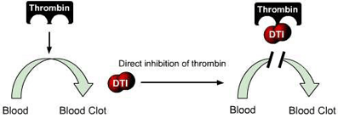
Dabigitran (Pradaxa®)
Prodrug
Requires conversion by liver to its active form
Directly Inhibits free and clot bound thrombin
Prevents conversion of fibrinogen to fibrin which prevents clot formation
Inhibits thrombin activation of platelets
Rapid Onset of Action
Peak serum levels 1hr after oral administration (on empty stomach)
Low Oral Bioavailability (3-7%)
Increased to 75% if capsules are opened
Half Life 12-17 hours
Dosed twice daily (BID)
80% of dose Eliminated by Kidneys
Dosage adjustments in renal impairment
Dialyzable
P-Glycoprotein (P-gp) Substrate
Does not inhibit or induce
Caution when given with P-gp inhibitors and inducers
50% increase in plasma levels when given with Amiodarone
Notes:
(Linda)
Onset is delayed to 2 hrs with a high fat meal but end result is the same (no change in bioavailablity)

Slide 11
Dabigitran (Pradaxa®)
Dosage: 150mg orally twice daily
(Prior to starting - Renal Function should be assessed)
75mg twice daily in renal clearance 30-50ml/min
Not recommended in patients with clearance <30ml/min
Adverse Effects
Gastrointestinal (GI) - 35%
dyspepsia, abdominal discomfort, epigastric discomfort, reflux, esophagitis, peptic ulcer, gastritis, GI Bleeding
Bleeding - 16%
Hypersensitivity Reactions - <0.1%
Urticaria, rash, pruritus, allergic edema, anaphylaxis
Administration
Must be stored in original container (No Pill Boxes)
May take with or without food
Swallow capsules whole
Contraindicated in mechanical heart valves and active bleeding
Cost - $300.44/month
Based on average wholesale price for 60 tabs
of 150mg or 75mg strengths
Notes:
Linda

Slide 12
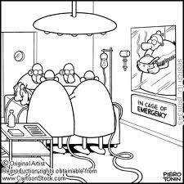
Dabigitran Monitoring and Reversal
Routine lab test monitoring not indicated
aPTT – (activated partial thromboplastin time)
recommended at 2x control
ECT (ecarin clotting time)
TT (Thrombin Time)
PT/INR (Protime) may or may not be affected
Cannot be used for monitoring
Management of Bleeding – No Antidote
Activated Charcoal with in 1-2hrs of ingestion
Dialysis – may not be option in unstable patient
PCC (Prothrombin Concentrate Complex)
4 Factor PCC - II, VII, IX, X (not available in US)
3 Factor PCC - II, IX, X
aPCC – II, aVII, IX, X
Feiba NF® (Baxter Healthcare) 50IU/kg
Recombinant activated Factor VIIa (rFVIIa)– NovoSeven®
Caution of potential fatal thrombus when giving aPCC and/or rFVIIa
Notes:
(Risik)
ECT is the best to assess bleeding risk but a test not widely available
TT – known test and sensitive to Dabigitran with a linear relationship but Standardization curves do not exist and need to be developed in order to be useful
Typically on full treatment doses INR is often reported at 1.5-2

Slide 13
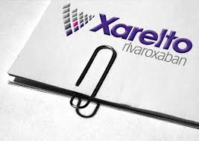
Factor Xa Inhibitors “-bans”
Rivaroxaban (Xarelto®)
FDA Approval in July 2011
For stroke prophylaxis and systemic embolism prophylaxis in patients with nonvalvular atrial fibrillation
For deep venous thrombosis (DVT) prophylaxis, which may lead to pulmonary embolism (PE), in patients undergoing knee or hip replacement surgery
Additional FDA Indication in November 2012
For the treatment of deep vein thrombosis (DVT) or pulmonary embolism (PE) and for the reduction in the risk of recurrent DVT and/or PE
Apixaban (Eliquis®)
FDA Approved in December 2012
For the prevention of stroke and systemic embolism resulting from nonvalvular atrial fibrillation
Edoxaban (Lixiana®)
Currently in phase III clinical trials
Betrixaban
Currently in phase III clinical trials
Notes:
LInda

Slide 14
Notes:
Risik

Slide 15
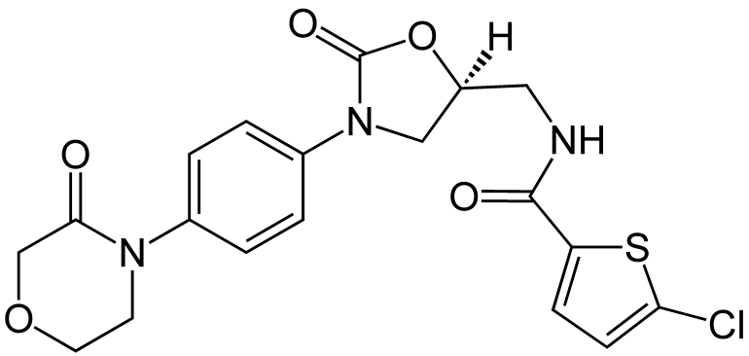
Rivaroxaban Trials
ROCKET-AF
Studied 20mg Daily in patients with nonvalvular AF
Compared >14,000 patients on rivaroxaban or dose adjusted warfarin
Noninferior to warfarin for the prevention of stroke or systemic embolism associated with nonvalvular AF
No difference in risk of major bleeding
Less incidence of intracranial and fatal bleeding with Rivaroxaban group
FDA Approval
EINSTEIN DVT & EINSTEIN PE
Studied 15mg BID for 21 days then 20mg once daily for a total 6 months for the treatment of DVT or PE
Compared against standard of care (Enoxaparin followed by Warfarin)
Noninferior to standard therapy
Extension of trial studied 20mg daily for an additional 6-12 months to prevent the recurrence of DVT/PE
VTE recurred in 1.3% vs. 7.1% in placebo group
Rates of bleeding were similar in each group
In patients with PE rates of bleeding were less in the rivaroxaban group (1.1% vs. 2.2%, p=0.003)
FDA Approval
RECORD 1-3
Studied 10mg once daily in patients undergoing hip or knee surgery
FDA Approval
Notes:
Risik

Slide 16
Rivaroxaban (Xarelto®)
Direct inhibitor of Factor Xa
Directly blocks the active site of factor Xa
Does not require cofactor such as Anti-thrombin III
required with fondaparinux
Activation of Factor Xa via Intrinsic AND Extrinsic pathways generates thrombin → clot formation
Indirectly inhibits platelets
Rapid Onset of Action
80-100% bioavailable
Peak serum levels 2-4 hrs after oral administration
Half-life 5-9 hours
Dosed once daily for stroke prevention and DVT/ PE prophylaxis
Twice daily for DVT/PE treatment
CYP3A4/5 substrate and P-gp substrate
Drug/drug interactions
Notes:
Linda

Slide 17
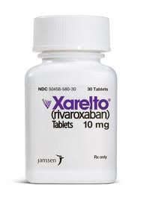
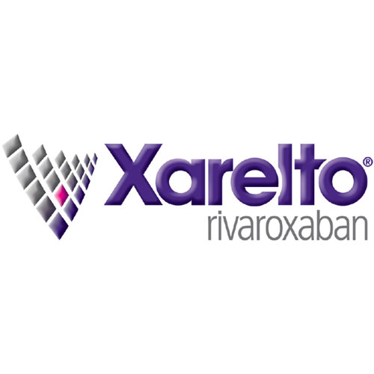
Rivaroxaban (Xarelto®)
Dosage:
20mg orally daily in patients with A.Fib
15mg orally twice daily x21 days then 20mg Daily for 6-12 months for patients with DVT/PE
10mg orally daily – For DVT/PE Prevention
X12 days for knee replacement surgery
X35 days for hip replacement surgery
Precaution in Renal Impairment
Clearance - 50-15ml/min: 15mg once daily
Clearance <15ml/min: avoid use
Avoid in <30ml/min in DVT/PE Prophylaxis patients
Avoid use in moderate to severe hepatic impairment
Adverse Effects
Bleeding 5.8%
0.3% Major bleeding
Administration
A.Fib patients should take with evening meal
15mg and 20mg taken with food – 10mg with or without food
In DVT/PE prevention with hip/knee patients - administer 6-10hrs post-op once hemostasis is attained
Cost - $300.42/month
Based on average wholesale price for #30 20mg tabs
Notes:
Linda

Slide 18
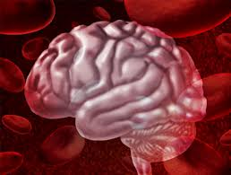
Factor Xa Inhibitors “-bans”
Rivaroxaban (Xarelto®)
FDA Approval in July 2011
For stroke prophylaxis and systemic embolism prophylaxis in patients with nonvalvular atrial fibrillation
For deep venous thrombosis (DVT) prophylaxis, which may lead to pulmonary embolism (PE), in patients undergoing knee or hip replacement surgery
FDA Approved Indication in November 2012
For the treatment of deep vein thrombosis (DVT) or pulmonary embolism (PE) and for the reduction in the risk of recurrent DVT and/or PE
Apixaban (Eliquis®)
FDA Approved in December 2012
For the prevention of stroke and systemic embolism resulting from nonvalvular atrial fibrillation
Edoxaban (Lixiana®)
Currently in phase III clinical trials
Betrixaban
Currently in phase III clinical trials
Notes:
Risik

Slide 19
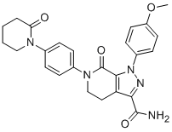
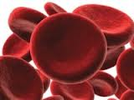
Apixaban Trials
AVERROES
Studied 5mg twice daily in patients with A. Fib for stroke prevention vs. Aspirin 81-324mg daily
Primary outcome was stroke or systemic embolism
51 in Apixaban group vs. 113 in ASA group
No difference in bleeding rates
Terminated early due to benefit of Apixaban over ASA
ARISTOTLE
Studied 5mg twice daily in patients with A. Fib for stroke prevention vs. Warfarin (INR 2-3)
Primary outcome was stroke or systemic embolism
Apixaban found to be superior to Warfarin
Less bleeding in Apixaban group
Lower mortality in Apixaban group
FDA Approval
ADVANCE 1-3
Studied 2.5mg twice daily for VTE prevention following total knee or hip replacement vs. Enoxaparin 30mg twice daily or 40mg daily
Failed to show non-inferiority in ADVANCE I For knee replacement vs. Enoxaparin 30mg twice daily
ADVANCE 2 Apixaban was superior to Enoxaparin 40mg daily for knee replacement
ADVANCE 3 Apixaban had lower rates of DVT/PE (n=27) vs. Enoxaparin 40mg daily (n=74)
No difference in bleeding in all 3 trials
Not FDA approved (yet?)
Notes:
Risik
Mention 2 studies we were involved in 1. ADOPT - Failing to meet primary outcome in DVT prophylaxis in medically ill patients. Enoxaparin did better with less bleeding. 2. AMPLIFY - DVT/PE treatment – results not out yet

Slide 20
Apixaban (Eliquis®)
Direct inhibitor of Factor Xa
Directly blocks the active site of factor Xa
Does not require Anti-thrombin III
Activation of Factor Xa generates thrombin → fibrin
Indirectly inhibits platelets
Rapid Onset of Action
50% bioavailable
Peak serum levels 3-4hrs after oral administration
Half-life 12 hours due to prolonged absorption
Dosed twice daily
CYP3A4 and P-glycoprotein substrate
Drug/drug interactions
Notes:
Linda

Slide 21
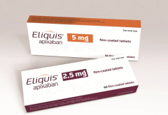
Apixaban (Eliquis®)
Dosage: 5mg twice daily
Decrease to 2.5mg orally twice daily if TWO of the following:
Age ≥80
Body weight ≤ 60 kg
Serum Creatinine (Scr) ≥ 1.5 mg/dl
2.5mg twice daily with strong inhibitors of CYP3A4 & P-gp
Black-Box warning against abrupt discontinuation in patients with A. Fib
Adverse Effects
Bleeding - 2.13%/year
Hypersensitivity <1%
Cost - $300.44/month
Based on average wholesale price for 60 tabs
of 2.5 or 5mg strengths
Notes:
(Linda)
May be taken with or with out food – food doesn’t seem to delay or enhance absorption.
Stong CYP3A4 and P-gp inhibitors include - Ketoconazole, Itraconazole, ritonivir – Inducers are carbamazepine, rifampin, phenytoin, st. johns wort – would result in increased risk of stroke to to induced metabolism and decreased exposure to apixaban
Has Few adverse effects but patients should be monitored for bleeding

Slide 22
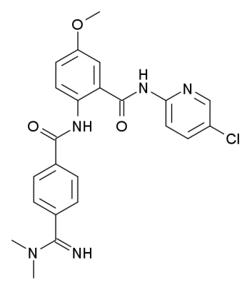
Factor Xa Inhibitors “-bans”
Rivaroxaban (Xarelto®)
FDA Approval in July 2011
For stroke prophylaxis and systemic embolism prophylaxis in patients with nonvalvular atrial fibrillation
For deep venous thrombosis (DVT) prophylaxis, which may lead to pulmonary embolism (PE), in patients undergoing knee or hip replacement surgery
FDA Approved Indication in November 2012
For the treatment of deep vein thrombosis (DVT) or pulmonary embolism (PE) and for the reduction in the risk of recurrent DVT and/or PE
Apixaban (Eliquis®)
FDA Approved in December 2012
For the prevention of stroke and systemic embolism resulting from nonvalvular atrial fibrillation
Edoxaban (Lixiana®)
Currently in phase III clinical trials in US
Approved in Japan
Betrixaban
Currently in phase III clinical trials
Longer acting once-daily
Notes:
(Risik)
Edoxaban – eTRIS study
Betrixaban = Portola Study

Slide 23
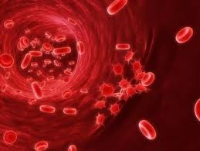
Factor Xa Inhibitors Monitoring and Reversal
Routine lab test monitoring not indicated
anti-Factor Xa assay
Increases proportionately
Standard curves need developed
Increases PT/INR and aPTT
Small increase and high variability
Cannot be used for monitoring
Management of Bleeding – No Antidote
Activated Charcoal with in:
8 hrs of ingestion for Rivaroxaban
3 hrs with Apixaban
No Dialysis – both highly protein bound
PCC (Prothrombin Concentrate Complex)
4 Factor PCC - II, VII, IX, X (not available in US)
3 Factor PCC - II, IX, X
aPCC – II, aVII, IX, X
Feiba NF® (Baxter Healthcare) 50IU/kg
Recombinant activated Factor VIIa
NovoSeven®
Caution of potential fatal thrombus when giving aPCC and/or rFVIIa
Notes:
Risik

Slide 24
…Then Why Monitor?
Very low body weight or Obese patients
Evaluate adherence and efficacy
Evaluate patients with complicating factors
Bleeding
Thrombotic
Multiple factors
Hepatic or Renal Impairment
Pediatrics
Overdose
Notes:
Linda

Slide 25
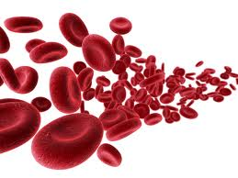
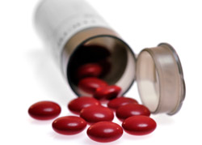
Advantages of New Oral Anticoagulants
Oral administration
Rapid onset
Short half-life
Rapid offset
Predictable Response
No routine monitoring
Fixed Dosing
Limited Drug-Drug interactions
No Food – Drug interactions
Potentially more Cost Effective
No monitoring
Less adverse events
Notes:
Risik

Slide 26
Disadvantages
Lack of routine monitoring
No antidotes
Dosage adjustments for some patients
Cost
Short-half life
Loss of activity if doses missed
Notes:
Linda

Slide 27
References
Pradaxa (dabigatran) package insert. Ridgefield, CT: Boehringer Ingelheim Pharmaceuticals, Inc.; 2012 Nov.
Connolly SJ, Ezekowitz MB, Yusuf S, et al. Dabigatran versus warfarin in patients with atrial fibrillation. N Engl J Med 2009;361:1139-51.
Oldgren J, Budaj A, Granger CB, Khder Y, Roberts J, Siegbahn A, Tijssen JG, Van de Werf F, Wallentin L. Dabigatran vs. placebo in patients with acute coronary syndromes on dual antiplatelet therapy: a randomized, double-blind, phase II trial.. Eur Heart J 2011 Nov;32:2781-9
Eriksson BI, Dahl OE, Rosencher N, et al. Dabigatran etexilate versus enoxaparin for prevention of venous thromboembolism after total hip replacement: a randomised, double-blind, non-inferiority trial. Lancet 2007;370:949-56.
Eriksson BI, Dahl OE, Rosencher N, et al. Oral dabigatran etexilate vs subcutaneous enoxaparin for the prevention of venous thromboembolism after total knee replacement: the RE-MODEL randomized trial. J Thromb Haemost 2007;5:2178-85.
Miyares MA, Davis K. Newer oral anticoagulants: a review of laboratory monitoring options and reversal agents in the hemorrhagic patient. Am J Helath-Syst Pharm. 2012; 69:1473-84.
Feiba NF (anti-inhibitor coagulant complex) prescribing information. Westlake Village, CA: Baxter Healthcare; 2011 Feb.
Xarelto (rivaroxaban) package insert. Titusville, NJ: Janssen Pharmaceuticals, Inc.; 2011 Jul.
Patel MR, Mahaffey KW, Garg J, et al. Rivaroxaban versus warfarin in nonvalvular atrial fibrillation. N Engl J Med 2011;365:883-91.
Bauersachs R, Berkowitz SD, Brenner B, et al; EINSTEIN Investigators. Oral rivaroxaban for symptomatic venous thromboembolism. N Engl J Med. 2010;363:2499-510.
The EINSTEIN-PE Investigators. Oral Rivaroxaban for the Treatment of Symptomatic Pulmonary Embolism. N Engl J Med 2012;336:1287-97.
Apixaban (Eliquis) package insert. Bristol-Myers Squibb Company; Princeton, NJ. Dec 2012.
Connolly SJ, Eikelboom J, Joyner C, et al. Apixaban in patients with atrial fibrillation. the AVERROES trial. N Engl J Med 2011;364:806-817.
Granger CB, Alexander JH, Mcmurray J, et al. Apixaban versus warfarin in patients with atrial fibrillation. the ARISTOTLE trial. N Engl J Med 2011;364:981-992
Lassen MR, Raskob GE, Gallus A, et al. Apixaban or enoxaparin for thromboprophylaxis after knee replacement. N Engl J Med. 2009;361(6);594-604
Lassen MR, Gallus A, Raskob GE, et al. Apixaban versus enoxaparin for thromboprophylaxis after hip replacement. N Engl J Med.2010:363(26);2487-98.

